Slide 1
EEG-based Cognitive Workload Estimation using Deep Convolutional Neural Networks
Shaked Aharon
Advisor: Dr. Oren Shriki

Slide 2
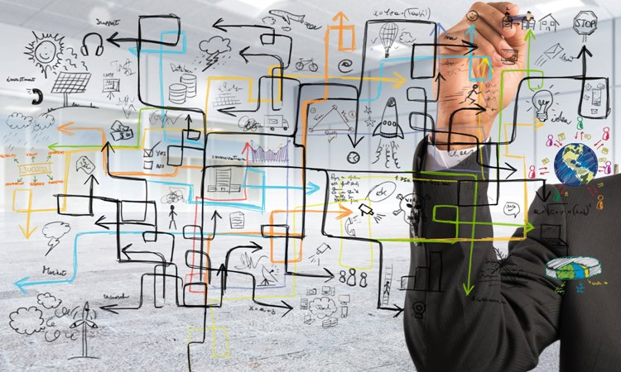

Motivation
Cognitive workload refers to the relative
load our limited cognitive resources.
High workload affects decision making and may lead to fatal errors even in routine procedures.
Monitoring workload has many applications from e-learning to monitoring drivers and pilots.

Slide 3
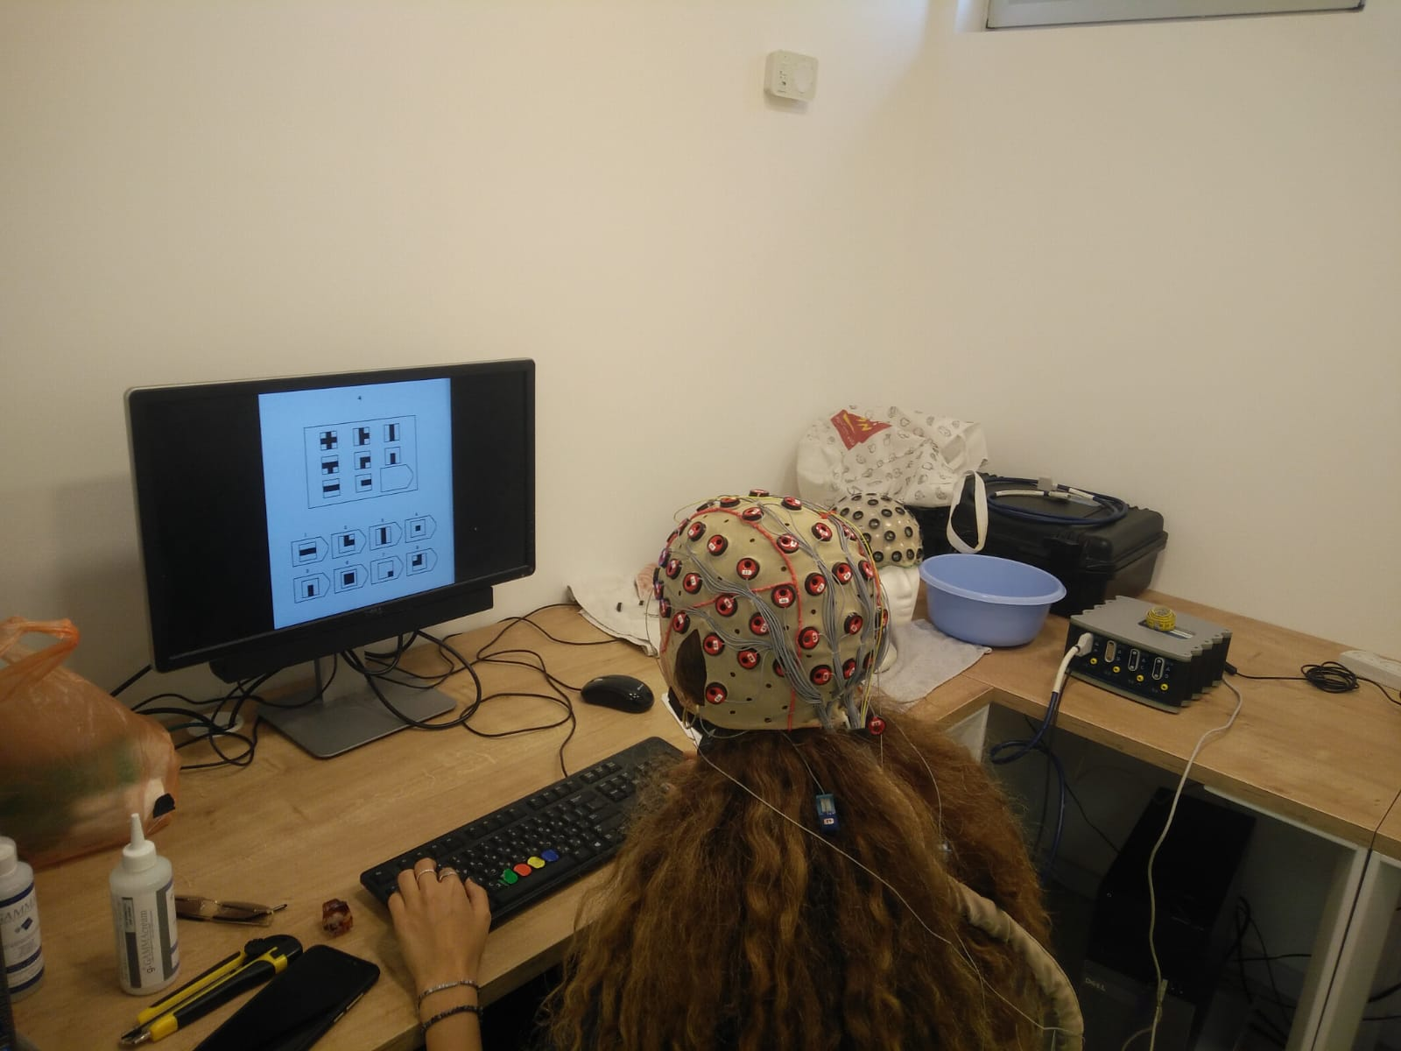
Collecting the Data
Raven’s Matrices test is a well established intelligence test, with questions in an increasing level of difficulty.
52 Subjects’ electrical brain activity was monitored using EEG kit, while taking the Raven’s matrices test [2].
EEG signal is a dynamic time series signal across multiple electrodes on the scalp.

Slide 4
Data Preprocessing
Questions were divided to 3 levels of difficulty.
EEG signal was bandpass filtered, cut into 2.5s trials and labeled by question difficulty.
Minimal preprocessing was made, to determine whether the network can learn to extract features from raw EEG signal.
Notes:
Cutting into trials due to every question recording was of different length
So far, most EEG decoding tools used handcrafted feature extraction to reduce data dimensionality. That required expert knowledge in the field of study.
On our data, Nir, which is a doctorant at XXXXXXXXXXXXX, used furrier transform to move to frequencies X power rather then time.
Thus dropping dimensionality from 62*641 = 39,742 per sample to XXXXXXXXXXX(nir’s dimensions) per sample

Slide 5
Convolutional Neural Networks (CNN)
CNN can exploit the hierarchical structure found in natural signals, and learn high level features by combining lower level features learned by the previous layers.
In images: edges -> simple shapes -> complex shapes.
Recent publications [1] showed that advancements in deep learning (such as dropout, ELU, batch norm, different training strategies) can help decoding motor imagery EEG signal, and proposed follow-up research on different EEG decoding tasks.
Notes:
EEG decoding tasks usually have very limited data.
For this reason, CNN wasn’t considered as a valid method for EEG decode, as it require a lot of data for training.
Dropout - set some inputs to 0 for each training update. Helps not to rely too much on a single feature, also resembles training on ensemble of networks
Batch norm - standardizes intermediate outputs to zero mean and unit variance – it helps keeping the input of layers close to normal distribution

Slide 6
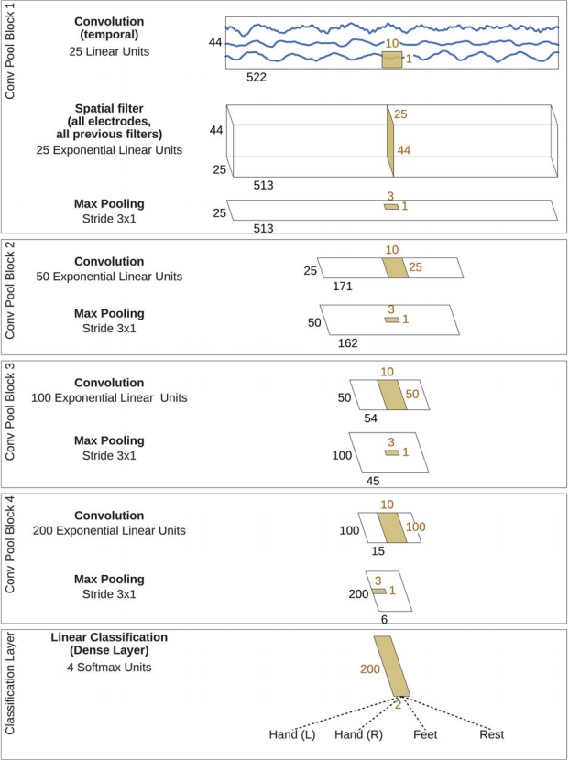
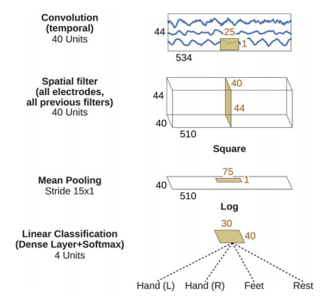
Architectures
We evaluated 2 architectures:
Deep CNN
Shallow CNN
Notes:
Deep: 4 convolutional-max pooling blocks
First block designed to handle EEG input: only logical separation (no activation function between layers)
First part: each filter performs convolution over time across single electrode.
Second: each filter does spatial filtering for all possible pairs of electrodes, (for the output of the first part) – linear combinations of all possible pairs
Fully connected softmax at the end
Shallow: architecture inspired by FBCSP method
first 2 layers – same as for deep architecture, convolution over time is performed across 25 timestamps (rather then 10)
Square + mean pooling + log – trial log variance computation step
All stages are in a single block, so all can be optimized together
Original Paper [1] tested different design choices. Any combination without batch norm, elu & dropout worsened performance.

Slide 7
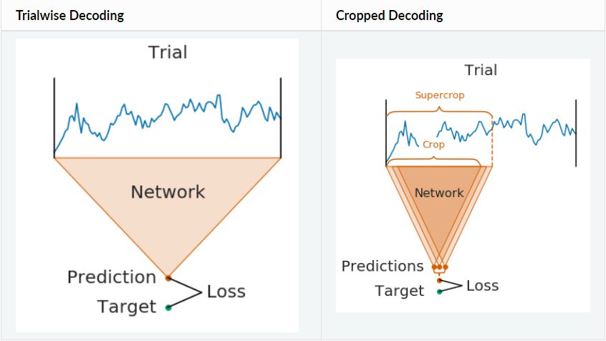
Training Strategies
We evaluated 2 different training strategies: trialwise & crops.
Cropping strategy uses a sliding window across trial. Each crop receives same label as full trial.
Cropping strategy increased dataset size by 11%, for 33% overlap. (Higher overlap would result in further increase)

Slide 8
Single Subject Training vs Cross Subject & Finetuning
We trained and evaluated each architecture and each training strategy across single subject training and cross subjects training with single subject finetuning.
We wanted to test whether the network can learn features that are common across all subjects.

Slide 9
Results

Slide 10
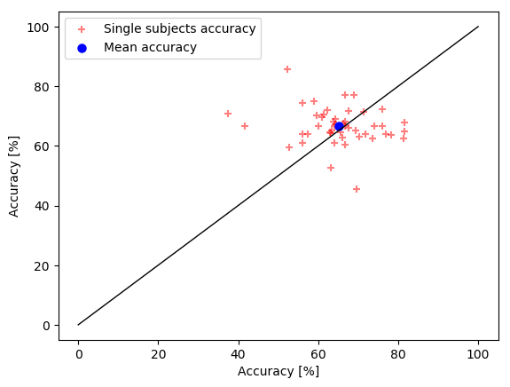



Models | Shallow Trialwise | Shallow Cropped | Model Accuracy
Deep Trialwise |  |  | 66.62%
Deep Cropped |  |  | 66.98%
Model Accuracy | 65.25% | 63.54%
Single Subject Training
The Deep model outperformed the shallow model across both training strategies.
The Deep model with the cropped training strategy performed best with 66.98% accuracy.

Slide 11
Models | Shallow Trialwise | Shallow Cropped | Model Accuracy
Deep Trialwise |  |  | 11.11%
Deep Cropped |  |  | 11.11%
Model Accuracy | 11.11% | 11.11%
Cross Subject & Finetuning
As can be seen, the Deep
Disclaimer: when training across subjects, model might have trained on some single subject trials, which it was tested on afterwards.

Slide 12
Models | Shallow Trialwise | Model Accuracy
Deep Trialwise |  | 11l11%
Model Accuracy | 1111%
Final Results
As can be seen, the Deep
Confusion matrix X2

Slide 13
Conclusions & Follow up Research Suggestions
Conclusions:
We showed that CNN are a valid method for EEG decoding, removing the need expert knowledge in the field of study.
Relative to other methods, CNN have very short prediction time, making it a great method for real-time decoding.
Follow up:
Feature extraction
Divide to more labels
Evaluate further innovations in the field of computer vision

Slide 14


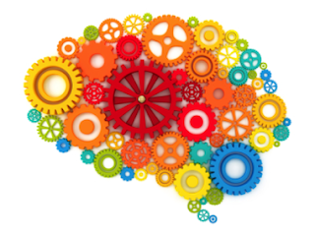

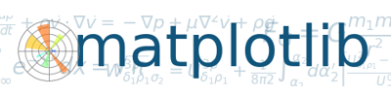
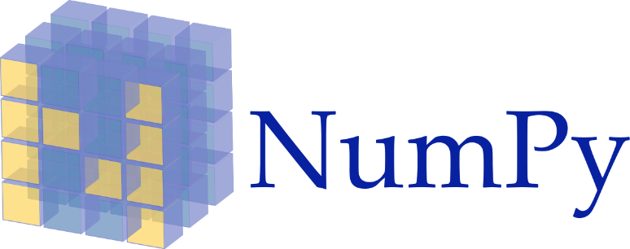
Bibliography & Technologies
Schirrmeister RT, Springenberg JT, Fiederer LD, Glasstetter M, Eggensperger K, Tangermann M, Hutter F, Burgard W, Ball T. Deep learning with convolutional neural networks for EEG decoding and visualization. Human brain mapping. 2017 Nov;38(11):5391-420.
Friedman N, Fekete T, Gal K, Shriki O. EEG-based Prediction of Cognitive Load in Intelligence Tests. Front. Hum. Neurosci. 13:191.
BrainDecode

Slide 15
Questions?

Slide 16
Thank You!

